Slide 1
FYP Open House Project
Admin features
By Teo Yu Cheng

Slide 2
Table of Contents
Recap of Mid-Term Presentation
Tools and Technologies Used
Features added (After mid-term presentation on week 6)
Challenges faced
Learning Outcomes
Demonstration of Admin features

Slide 3
Recap of Mid-term Presentation
From week 6

Slide 4
Recap of Mid-term presentation
Task: Using ReactJS to develop the Admin features in Visual Studio Code
Admin Login
Select Booth
QR-code Scanner
Feedback given:
Add Redemption and Engraving links to the Select Booth page
In Qr-code scanner, ensure that the booth admin can scan a visitor’s qr-code once per booth.
Qr-code scanner display pop-up message to indicate that the booth admin successfully scan the visitor’s qrcode

Slide 5






Tools and Technologies Used
Programming Language
ReactJS
Deployment Platform
AWS S3
IDE
Visual Studio Code
Database
Mysql Workbench
Source Control
Azure Devops
GIT for Windows

Slide 6
Features Added
After Week 6 presentation

Slide 7
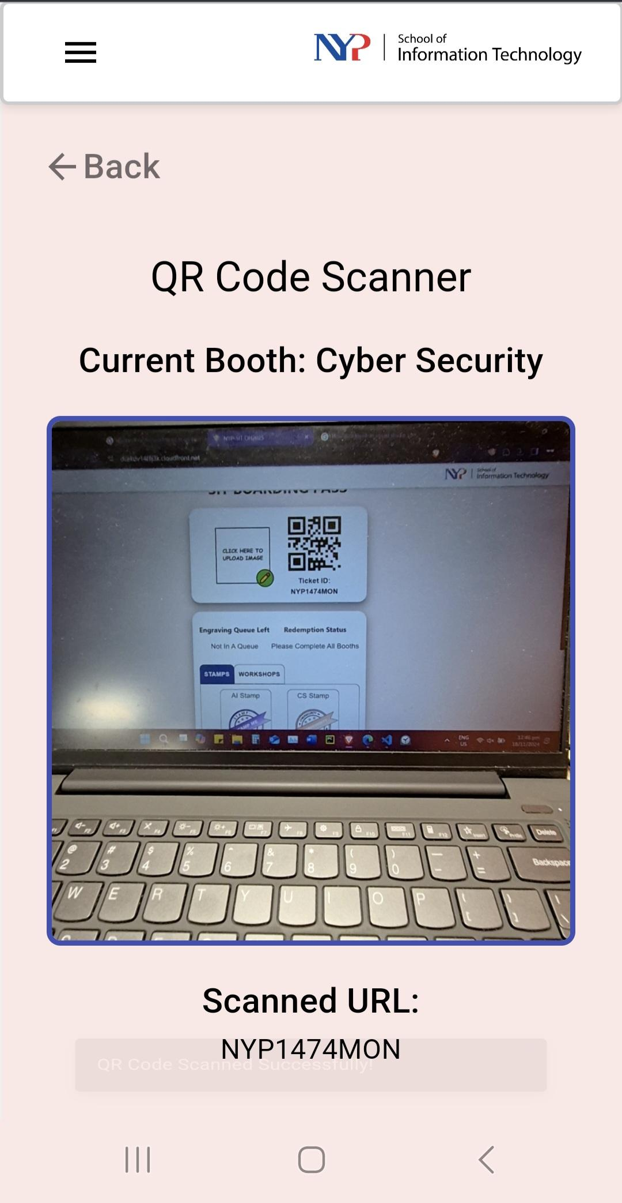
Features added
Integration between Admin and Visitor side
Booth Admin side Qr-code scanner:
Before: It was a typical Qr-code scanner that scans links.
After: Qr-code scanner will scan the Visitor’s QR code, which will call the booth / workshop API to activate the stamp at the Visitor-side.

Slide 8
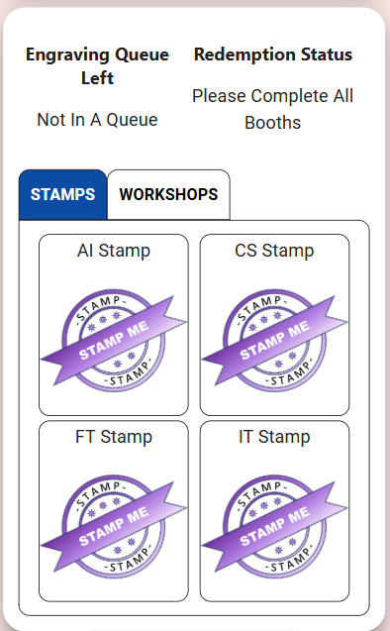
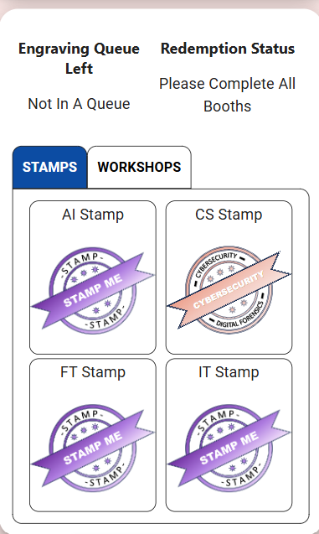
E.g. Before/After at Visitor side’s Cyber-Security Booth
Before Visitor stamp is activated
After Visitor stamp is activated

Slide 9
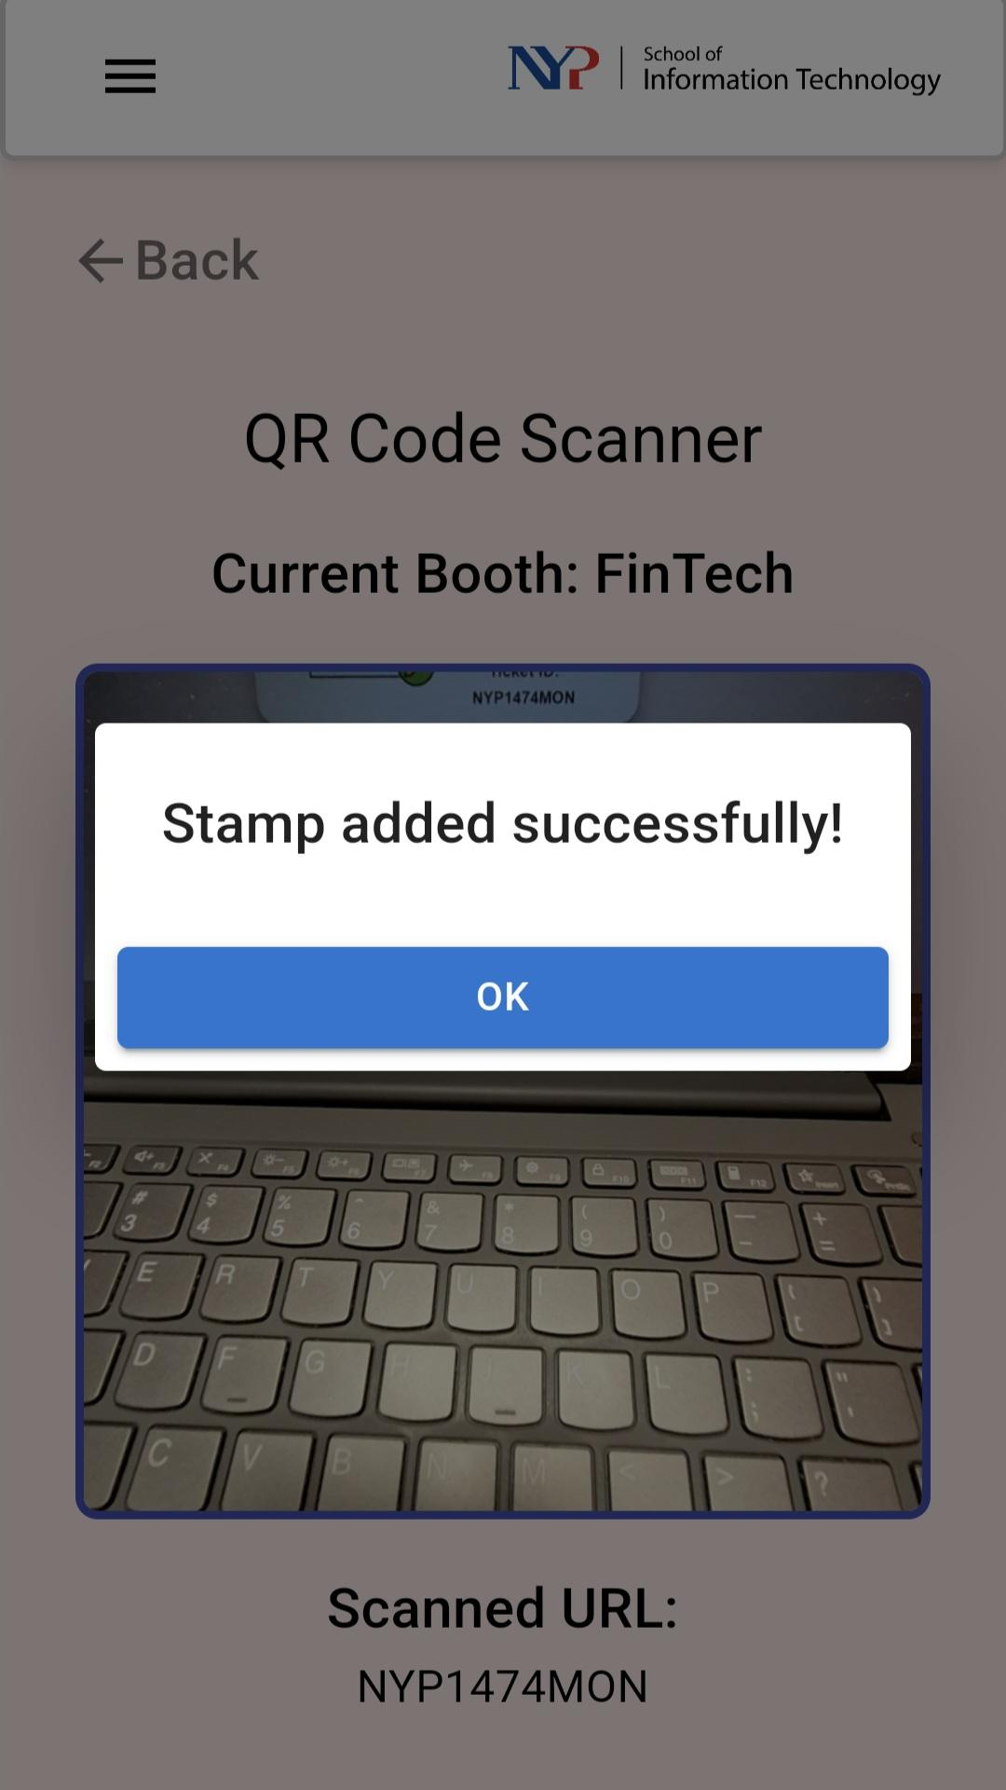
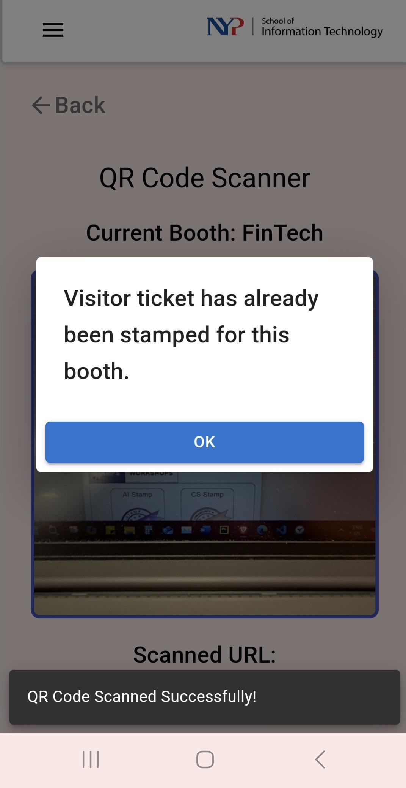
Features added
Qr-code scanner display pop-up message to indicate that the booth admin had either successfully, unsuccessfully or already scan the visitor’s qrcode.
Ensure visitors qr-code can only be scanned once per booth to prevent duplicate scans.

Slide 10
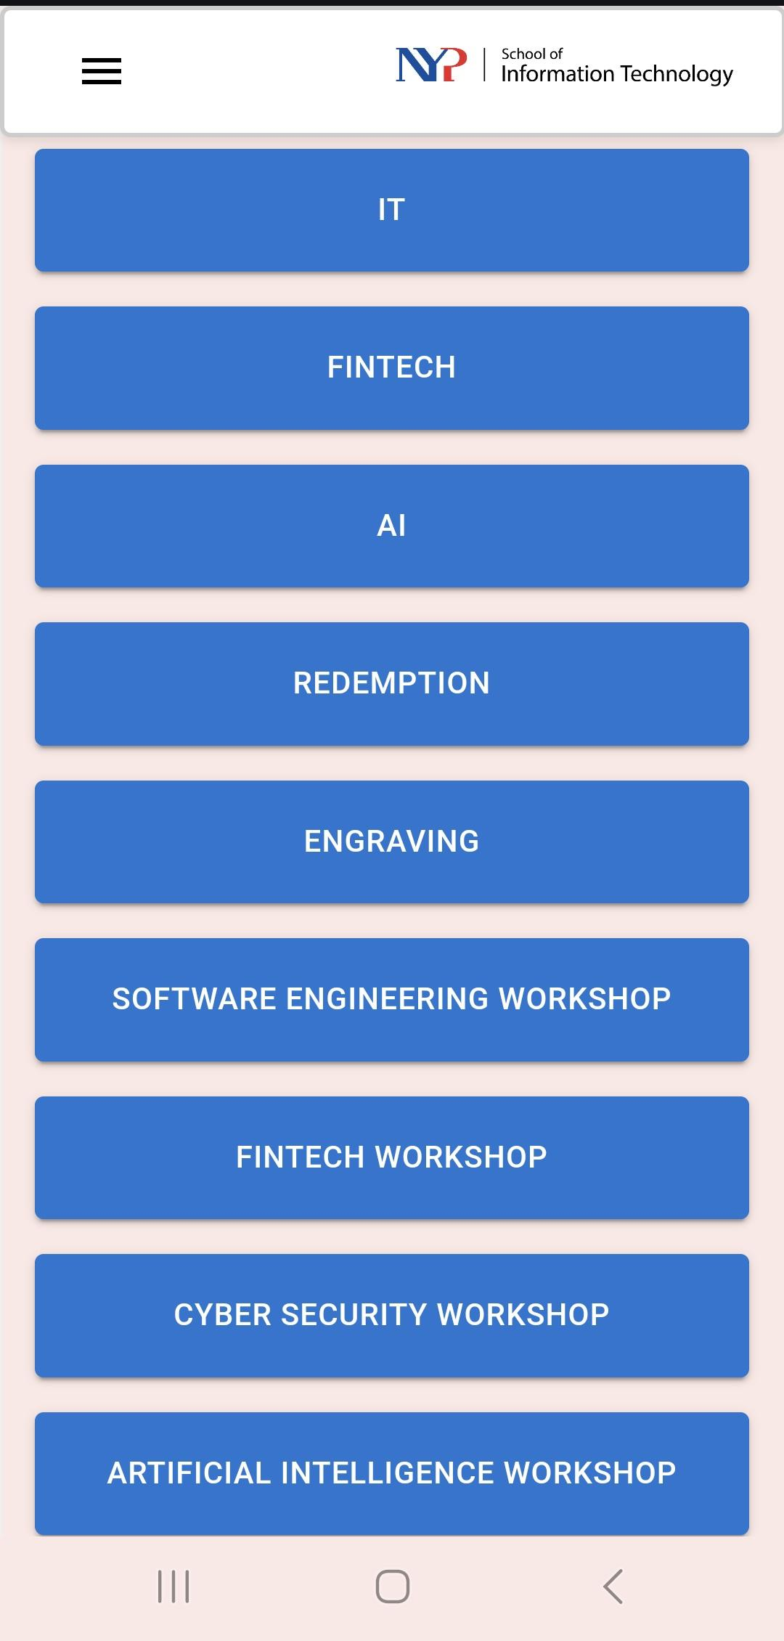
Features added
Rename of Booths and Workshops for easier identification of booths / workshops.
Examples:
From Data Analysis to IT booth
From Workshop A to Software Engineering Workshop etc
After changes shown at the screenshot ->

Slide 11
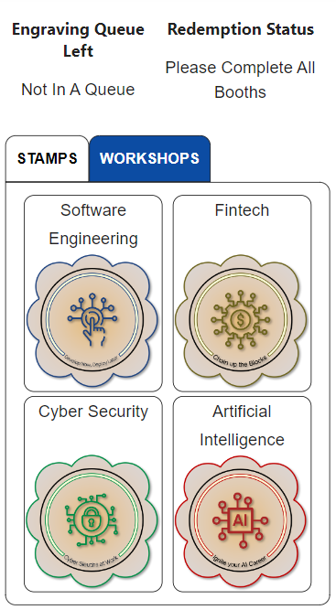
Features added
In the Qr-code scanner, i had re-coded a portion of the code from Workshops A to D (originally using Booths API temporarily) to Software Engineering, FinTech Workshops etc as the workshops uses a separate API used to activate the Visitor’s stamp.

Slide 12
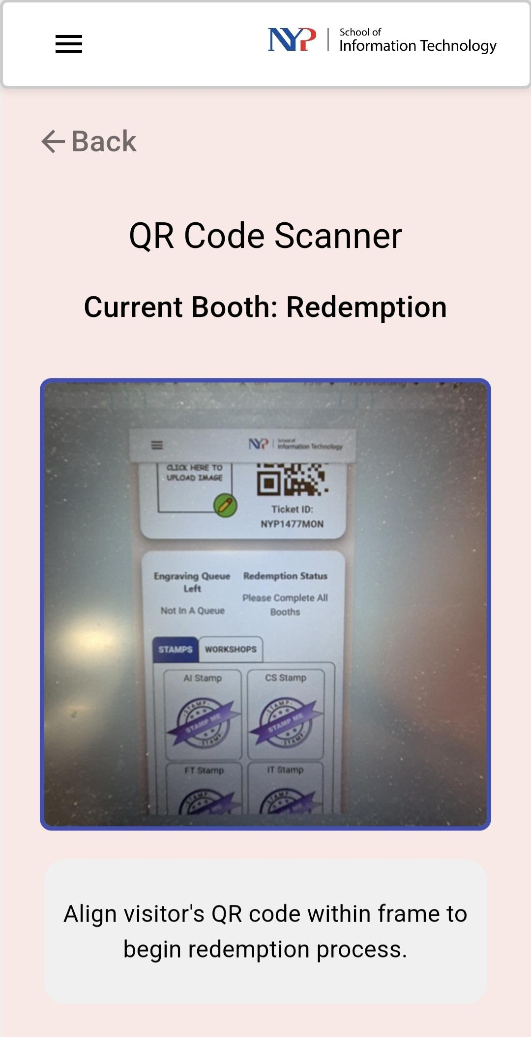
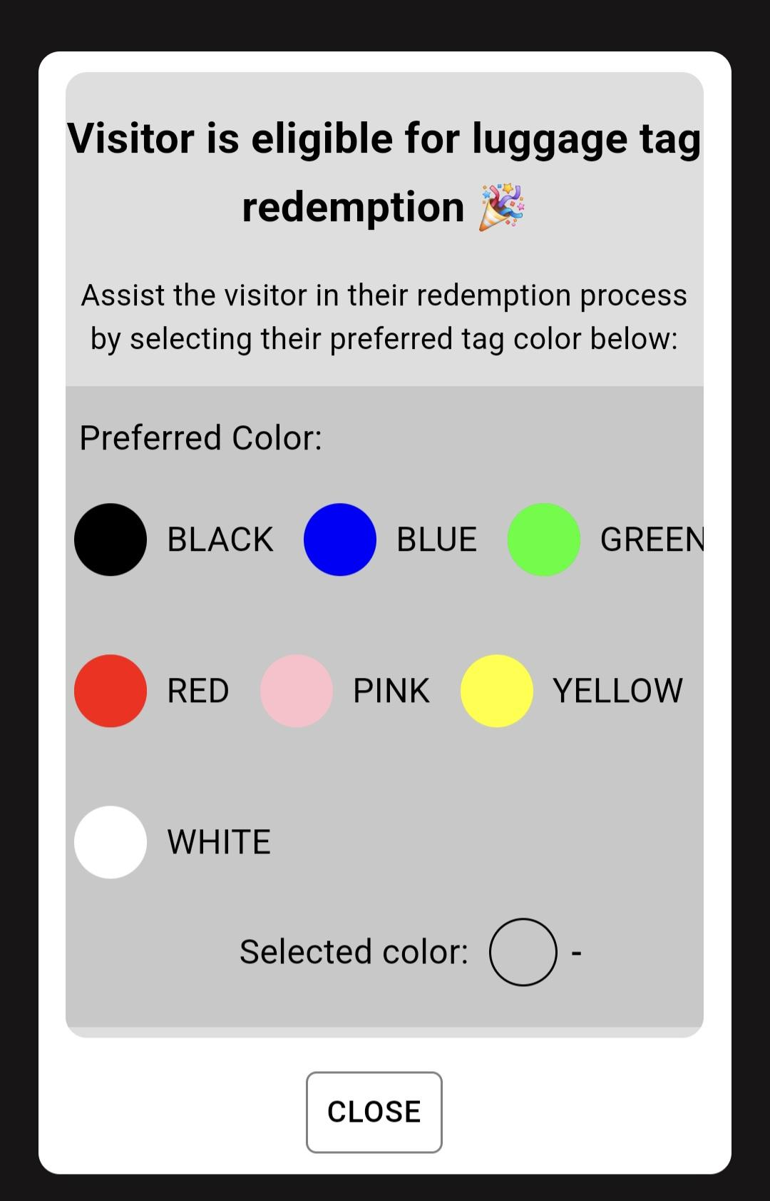
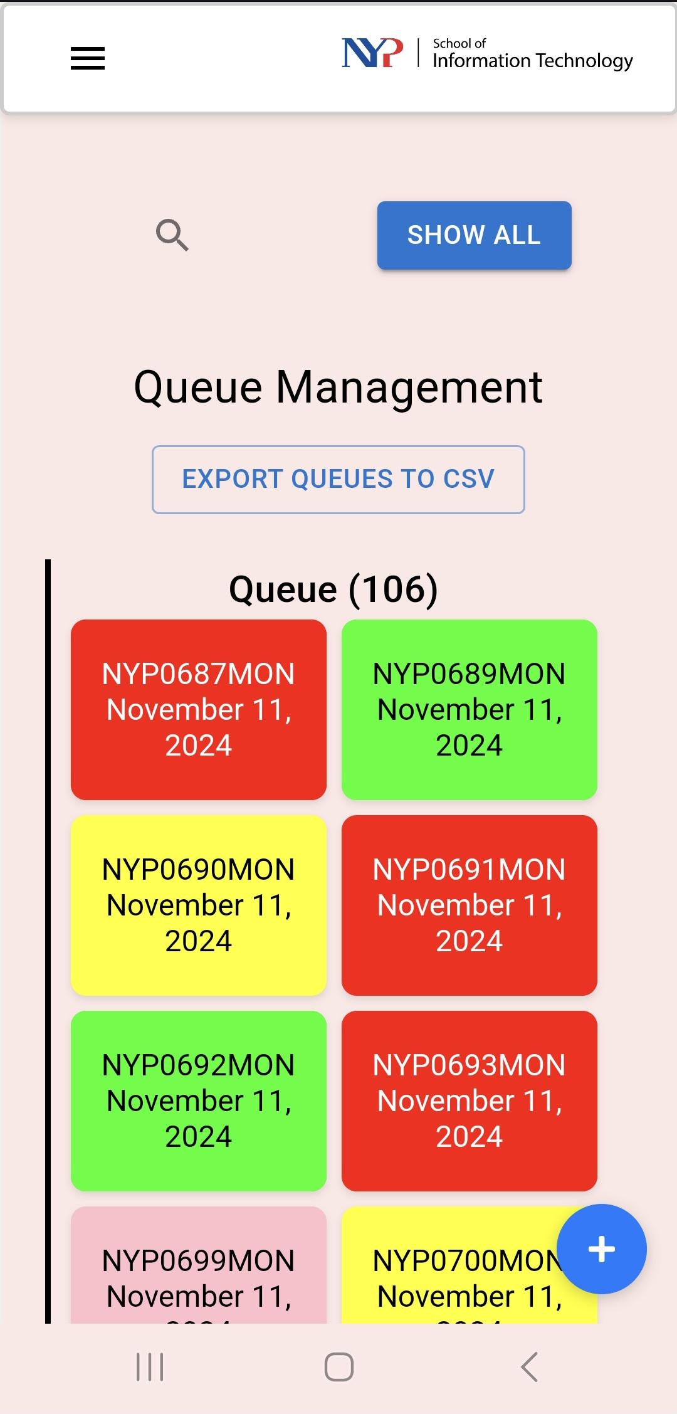
Features added
Add Redemption and Engraving links to the Select Booth page to ensure easy accessibility for the booth admins

Slide 13
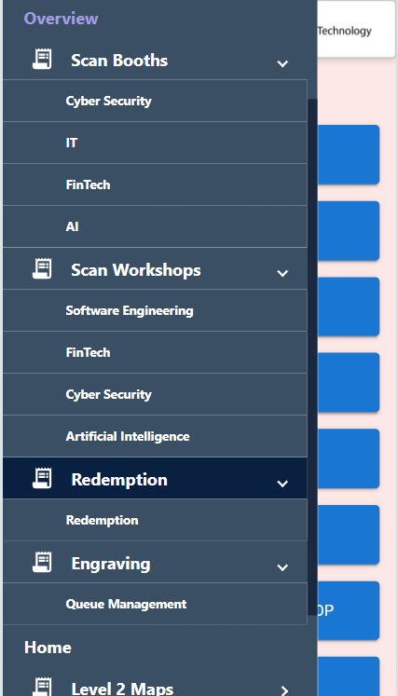
Features added
At the left-side nav bar, i have added links to:
Booths (linked to Qr-code scanner)
Workshops (linked to Qr-code scanner)
Redemption
Engraving
Another way for the booth admin to Access the booth / Workshop Qr-code scanner

Slide 14
Challenges faced
During FYP

Slide 15
Challenges faced during FYP
Uploading the codes to Amazon S3 for deployment
When i had to deploy my codes to Amazon S3, I found it challenging to deploy the codes to Amazon S3
Due to my concerns that i may mess up the deployment of codes if i had done it incorrectly.
Fortunately, one of my groupmates guided me through the Amazon S3 deployment process.
I had managed to create my step-by-step guide of deployment process to Amazon S3 for future reference and to deploy the codes to Amazon S3 independently.

Slide 16
Challenges faced during FYP
Troubleshooting of codes
When booth-admin access the qr-code scanner via the left nav-bar,
it works for the first booth, but after that the booth-admin will have to manually refresh the page, which is inconvenient for the booth admins to use.
It took quite a while for me to find out where the problem was in the Custom navbar page in Visual Studio Code, which was at const handleBoothClick.
At times i was desperate to fix the problem as soon as possible.
Eventually, i managed to find a workaround in the issue by using window.location.reload(); , this forces the qr-code scanner accessed via the left-nav bar to refresh automatically, allowing the booth admin to continuous scans of the visitors qr-code without having to manually refresh.

Slide 17
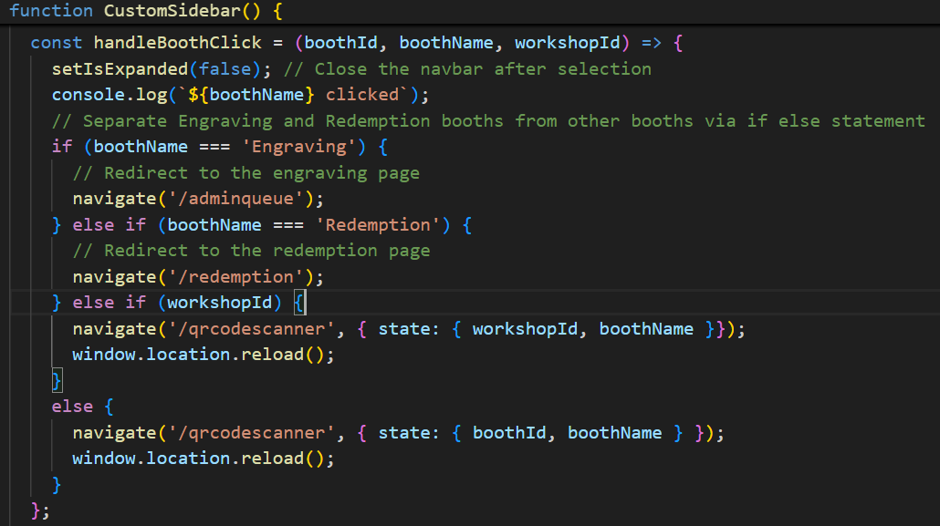
Screenshot of the solution to the issue

Slide 18
Challenges faced during FYP
During the FYP integration, i was indecisive in communicating an issue effectively to my groupmate,
As in messaging the code issue to groupmate, I was overthinking about should i send the message to my groupmate or not? How will he respond etc?
Resulting in me send, unsend and resend the message again, causing my groupmate to be confused on what my intended issue is about.
I decided to overcome the indecisiveness by:
Taking some time to think and decide what to message before communication with a groupmate (e.g. be topic of discussion, specific about the code issue).

Slide 19
Learning Outcomes
During FYP

Slide 20
What have I learned during FYP?
Troubleshoot problems by being patient
When I faced a problem (e.g. code unable to run), i learnt that it takes time to identify the problem and try to implement a fix to the problem works well.
Learn more about:
ReactJS
Qr-code scanner
AWS S3
Communicate well with groupmates to ensure smooth Integration of codes into Azure DevOps repo
Especially voicing out the specific issue (e.g. code integration)

Slide 21
Demonstration of Admin features
Admin Login, SelectBooth and Qr-code scanner pages

Slide 22
End of Presentation
Thank you

